Slide 1
Operations Research Assignment
MATH F242
Group members :
Parth Poply (2016A7PS0249U)
Naman Sharma(2016A7PS0219U)
Deepesh Raul(2016A7PS0041U)
Shaun Fernandes(2016A7PS0290U)

Slide 2
Topic : Regression : Generalized Linear Models and Nonlinear Regression

Slide 3
Introduction
What is Regression ?
Regression is a statistical measurement used in finance, investing, and other disciplines that attempts to determine the strength of the relationship between one dependent variable (usually denoted by Y) and a series of other changing variables (known as independent variables).
Regression could be a way of finding the causal-effect relationship between the variables.

Slide 4
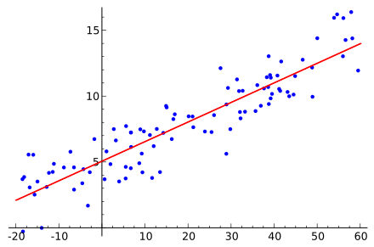
Introduction
This relationship is typically in the form of a straight line (linear regression) that best approximates all the individual data points. The line is more commonly also known as “Line of best fit”

Slide 5
Types of Regression
The two most basic types of regression are:
Linear regression
Non-Linear regression
Regression can be further classified being linear or multiple regression. General forms are as follows :
Linear regression: Y = a + bX + u
Multiple regression: Y = a + b1X1 + b2X2 + b3X3 + ... + btXt + u

Slide 6
Generalised Linear Model
In statistics, the generalized linear model (GLM) is a flexible generalization of ordinary linear regression that allows for dependent/response variables that have error distribution models other than a normal distribution.
The GLM generalises linear regression by allowing the linear model to be related to the response variable via a link function and by allowing the magnitude of the variance of each measurement to be a function of its predicted value.

Slide 7
Generalised Linear Model
There are three components to any GLM :
Random Component - refers to the probability distribution of the dependent variable (Y)
Systematic Component - specifies the independent variables (X₁, X₂, ... X_{k}) in the model
Link Function, η or g(μ) - specifies the link between random and systematic components

Slide 8
Examples : (Y = Dependent variable; X = Independent variable)
Y = Son’s Height X = Father’s Height
Y = Consumption Expenditure X = Income
Y = Crop yield X’s = temperature, rainfall, sunshine

Slide 9
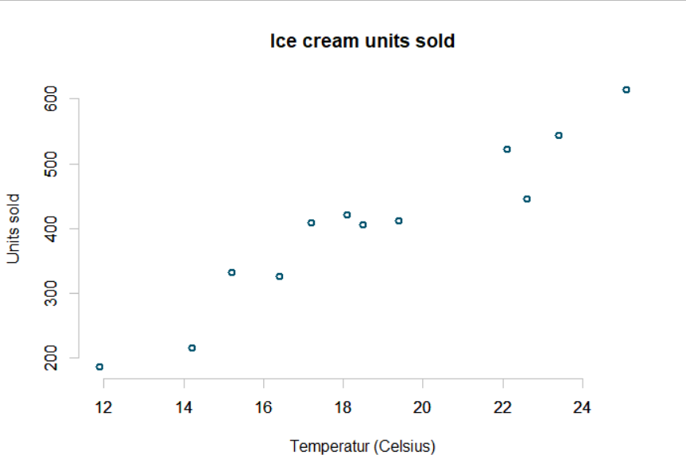
Implementing Linear Model in R
The dataset:
We are using a simple ice cream sold vs Temperature dataset to predict the number of ice cream units sold in a given temperature.

Slide 10
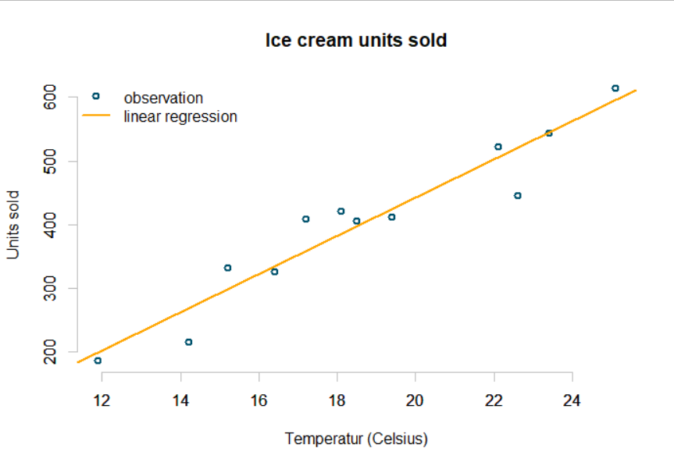
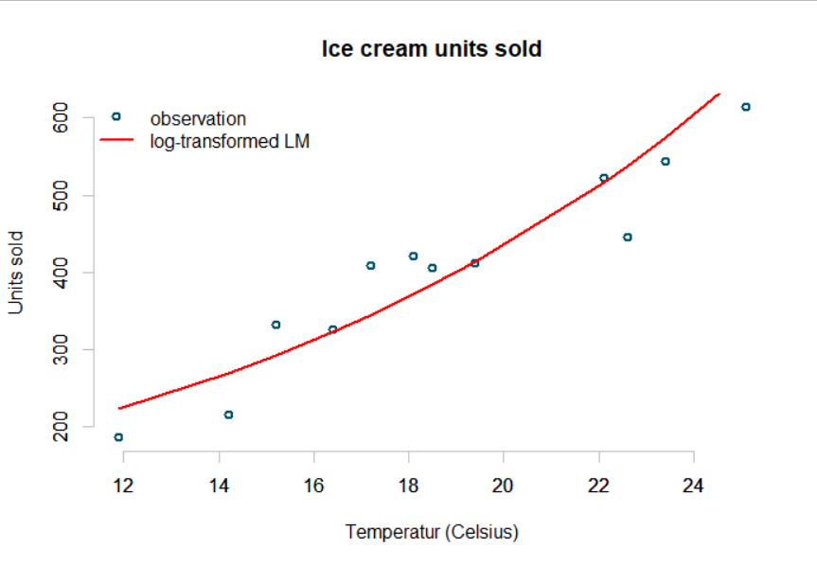
Regression Lines for Models
Linear Regression Log-Transformed Linear Regression

Slide 11
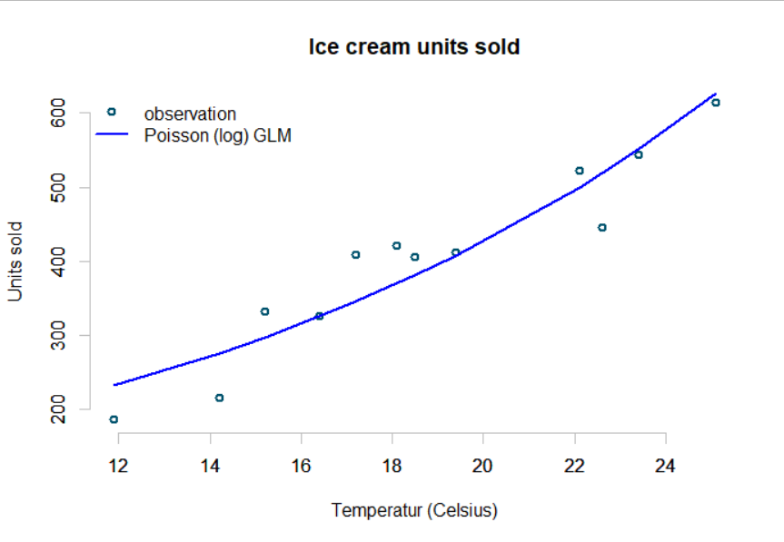
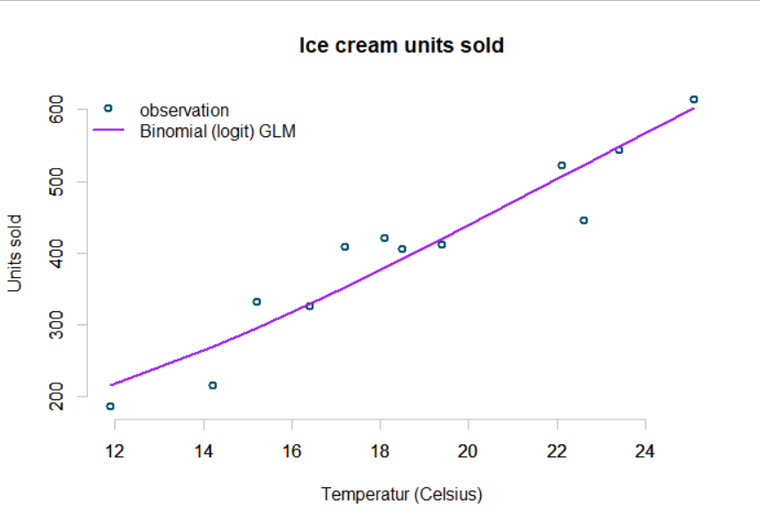
Regression Lines for Models
Poisson Regression Binomial Regression

Slide 12
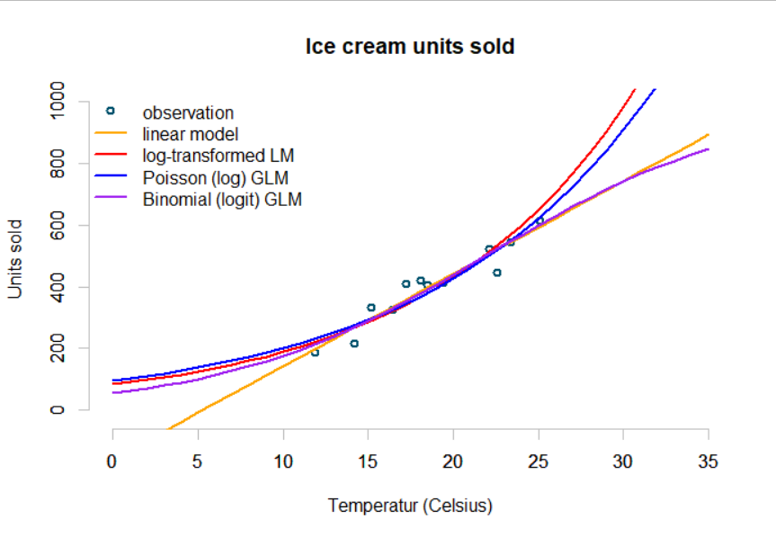
Regression Lines for Models
All plots Comparison:

Slide 13

Results
The Root Mean Square Error (RMSE) was calculated for each model. It was found that for the given dataset, the Poisson Regression model gives the least RMSE of all models, the Linear Regression giving the worst value.
This analysis tells us to use Poisson Regression Model over the other models for the given linear data.

Slide 14
Non-Linear Regression Analysis
Sometimes the relationship between the output and predictor variable may not be linear.
If we apply our linear model to non-linear data, the model will underfit and underperform. In order to overcome underfitting, we need to increase the complexity of our model.

Slide 15
Non-Linear Regression Analysis
There are different solutions that extend on the linear regression model approach to capture such non-linear effects, few of which are listed below:
Polynomial regression
Spline regression
Generalised additive model
Local regression

Slide 16
Polynomial regression
Relationship between dependent and independent variable modelled as an nth degree polynomial
General form:

Slide 17
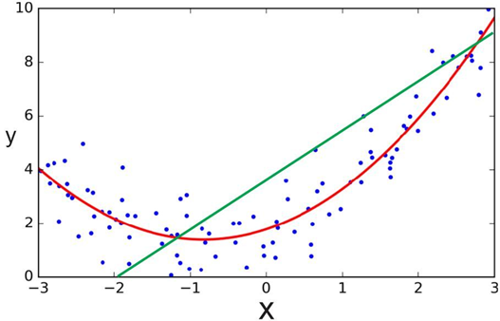

Slide 18

Spline regression
Non-parametric regression technique.
Knots
Piecewise functions

Slide 19
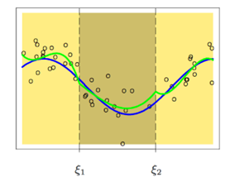

Slide 20
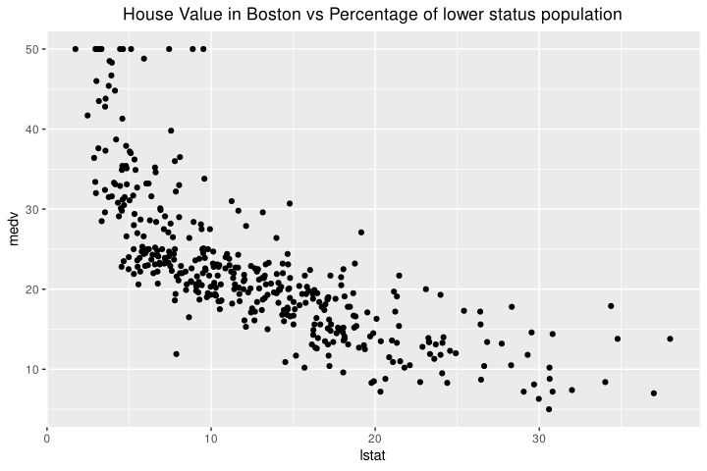
Implementing Non-Linear Model in R
The dataset :
We used a Boston housing data set (found in the MASS package in R), for predicting the median house value (medv), in Boston Suburbs, based on the predictor variable: percentage of lower status of the population (lstat).

Slide 21
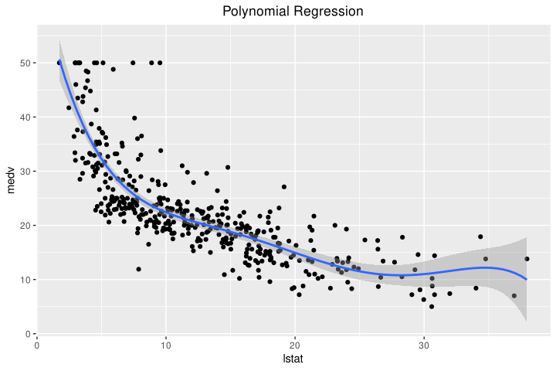
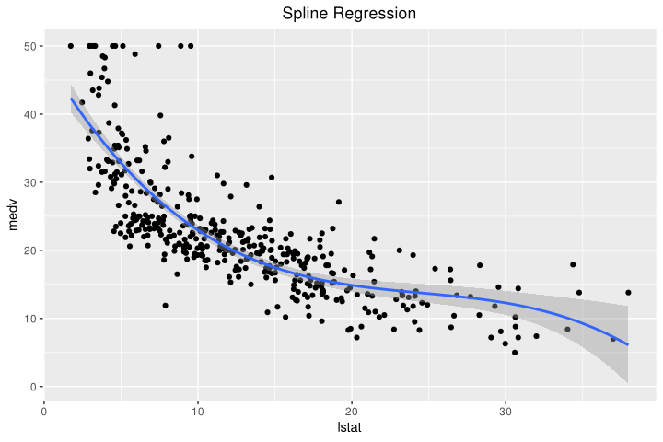
Regression Lines for Models
Polynomial regression Spline regression

Slide 22
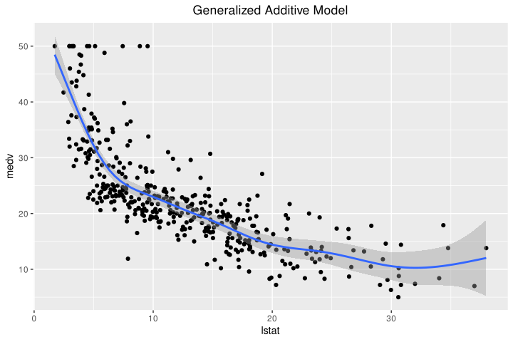
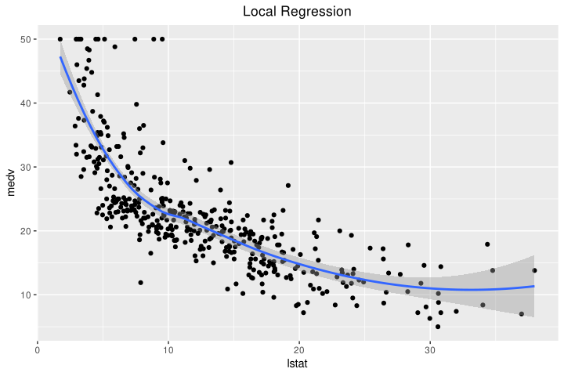
Regression Lines for Models
Generalised additive model Local Regression

Slide 23
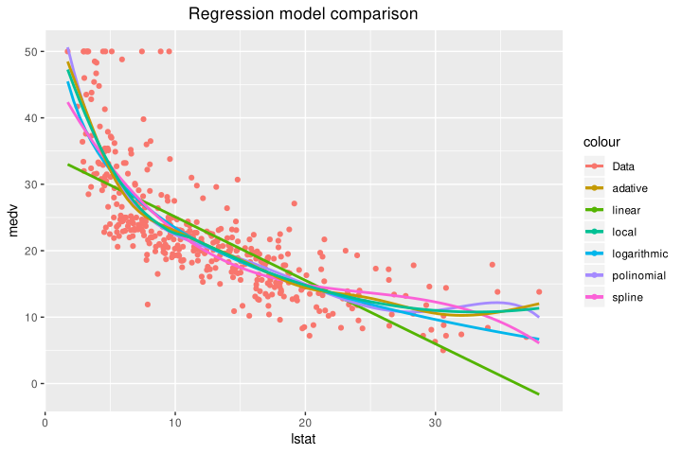
Regression Lines for Models
All Plots Comparison

Slide 24
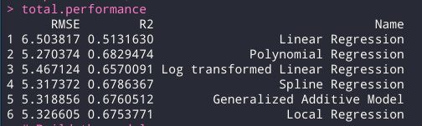
Results
The Root Mean Square Error (RMSE) and the R squared (R2) were calculated for each model. It was found that for the given dataset, the Polynomial regression model had the least error, and highest R square value.
All models performed similarly on the given test set except the Linear Regression model which performed the worst out of the lot.
From these results it can be inferred that Non-Linear regression works significantly better on certain data than linear regression models.

